Slide 1
Organic Agriculture

Slide 2
Notes:
VIDEO: Wording on food labels mislead consumers
Consumer Reports' Urvashi Rangan talks to the "CBS This Morning" co-hosts about a new survey that reveals many Americans are being misled by the wording on food labels. (Published June 16, 2014)
Source: https://www.youtube.com/watch?v=c9v93BphcKE

Slide 3
Quick Questions
What does the term natural mean in everyday context? What does it mean in regard to food?
What labels do you frequently see at the grocery store?
What role do you think the government should have in regulating food labeling?
What aspects of food production do you personally care about? Why?

Slide 4
Organic Agriculture is…
“a labeling term for food or other agricultural products that have been produced using cultural, biological, and mechanical practices that support the cycling of on-farm resources, promote ecological balance, and conserve biodiversity in accordance with the USDA organic regulations.”
- United States Department of Agriculture
Notes:
This is the UDSA official definition.

Slide 5
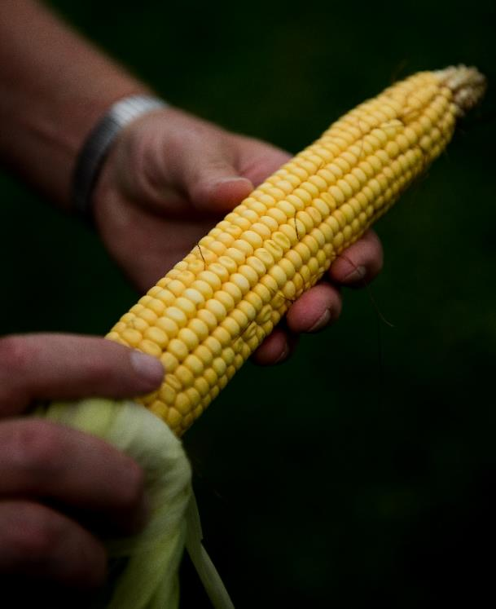
Organic Agriculture is…
A clear set of rules and practices that guide food and fiber production.
Regulated by the United States Department of Agriculture (USDA).
An evolving, consumer-driven, profitable sector of agriculture.

Slide 6
Goals of Organic Agriculture
Soil fertility
Ecological harmony
Biologically diverse agriculture
Humane treatment of animals
High-quality foods
Notes:
Maintain and build soil fertility
Restore, maintain and enhance ecological harmony
Build a biologically diverse agriculture
Promote humane treatment of animals
Produce high-quality foods

Slide 7
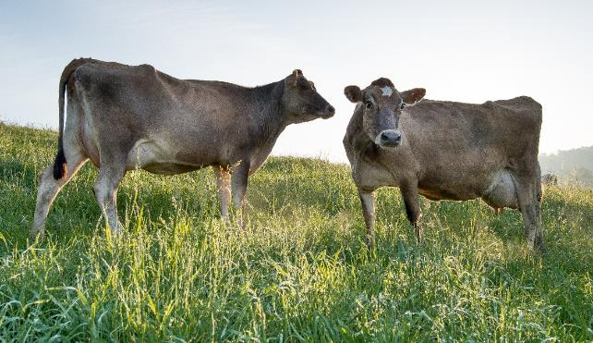
Organic Products are Made Without…
Genetically modified organisms (GMOs)
Antibiotic use
Synthetic fertilizers
Irradiation
Sewage sludge
Notes:
Organic agriculture prohibits methods and practices the USDA has deemed out-of-sync with the overarching goals of organic production.
Irradiation is the application of ionizing radiation for the preservation and sterilization of food.

Slide 8
Organic History
Organic agriculture was first recognized by the U.S. Government with the Organic Foods Production Act (OFPA) in the 1990 Farm Bill.
This Act called for the creation of a framework of rules to regulate organic food, called the National Organic Program (NOP).
Notes:
The farm bill is the primary agricultural and food policy tool of the federal government.

Slide 9
Organic History
The USDA saw a need for organic farmers and consumers to have a role in deciding the rules that oversee organic agriculture and labeling.
To achieve this, it established the National Organic Standards Board (NOSB) to suggest changes to the standards over time.
The NOSB is made up of 15 public volunteers from the organic industry.
Notes:
The NOSB is made up of volunteers who make recommendations on a wide range of issues involving the production, handling, and processing of organic products. Its members represent different areas of the organic industry: 4 farmers, 2 processors, 1 retailer, 1 scientist, 3 public interest advocates, 3 environmentalists, and 1 certifying agent.

Slide 10
National Organic Program
1979
Calif. creates first legal organic standard in U.S.
1990
Farm Bill
USDA Organic Foods Production Act
2002
Organic labeling rules go into
effect
1990
National Organic Program (NOP)
1992
National Organic Standards Board (NOSB)
2010
Organic pasture rule goes into effect
Notes:
1990
Before the Organic Foods Production Act, there was no national regulations on “Organic” Products. If a state had regulations, they were often different from their neighbors. This led to consumer confusion and distrust in the marketplace. The National Organic Program was established as a mandate of the 1990 Farm Bill.
1992
The National Organic Standards Board is a 15-member federal citizen advisory panel.
2002
The public submitted 40,774 comments on the proposed organic rule. It was the first time in history an industry fought for stricter standards for themselves and the first time the organic label was placed into production. This required all organic products in the United States to meet the national standards.
2010
The organic pasture rule requires all ruminant animals to graze on pasture during the grazing season.

Slide 11
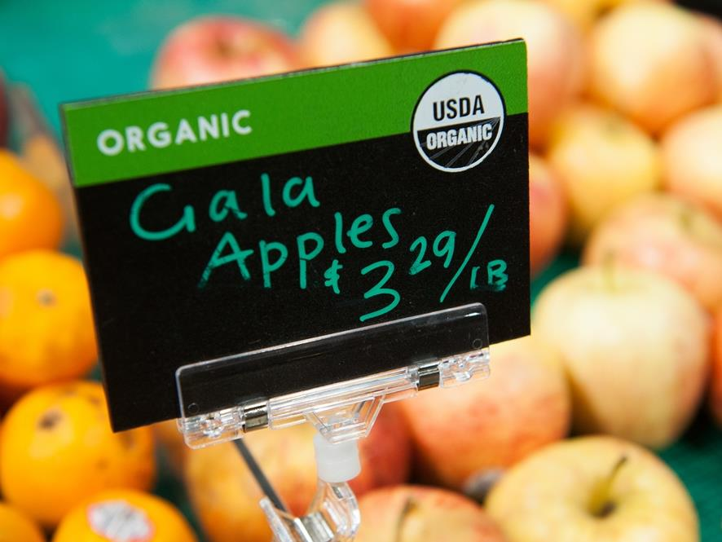
Notes:
VIDEO: What does organic really mean?
For a food product to have the organic label, it must contain at least 95% certified organic products. A product may be labeled as “Made with Organic __________” for products that contain at least 70% organically produced ingredients.
Source: http://www.youtube.com/watch?v=a-neHKYxn2M

Slide 12
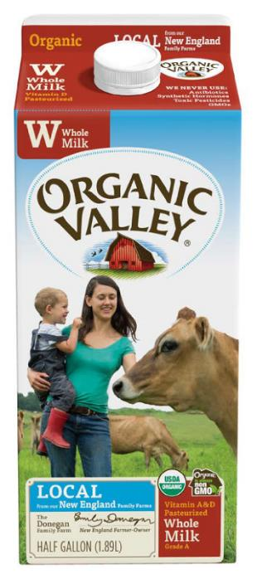
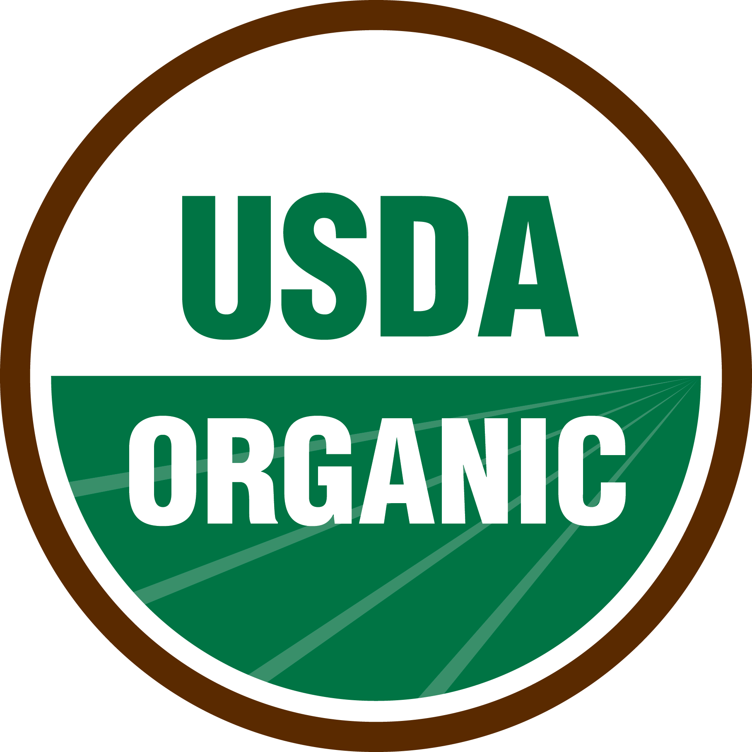
How Do Consumers Know a Product is Organic?
Notes:
The organic label can be found on the front label of any certified product. This guarantees the consumer that the product has met all of the USDA organic regulations from the farm to the store.

Slide 13
Organic Labeling
100% ORGANIC Contains only certified organic agricultural ingredients
ORGANIC At least 95% organic agricultural ingredients
MADE WITH ORGANIC _________ 70% or higher organic agricultural ingredients
Notes:
100% Organic
Raw or processed agricultural products in this category must meet these criteria:
All ingredients must be certified organic.
Any processing aids must be organic.
Product labels must state the name of the certifying agent on the information panel.
Organic
Raw or processed agricultural products in the “organic” category must meet these criteria:
All agricultural ingredients must be certified organic, except where specified on National List.
Non-organic ingredients allowed per National List may be used, up to a combined total of five percent of non-organic content (excluding salt and water).
Product labels must state the name of the certifying agent on the information panel.
Made with Organic Ingredients
Multi-ingredient agricultural products in the “made with” category must meet these criteria:
At least 70 percent of the product must be certified organic ingredients (excluding salt and water).
Any remaining agricultural products are not required to be organically produced but must be produced without excluded methods (see page 1).
Non-agricultural products must be specifically allowed on the National List.
Product labels must state the name of the certifying agent on the information panel.
Source: USDA (https://agr.wa.gov/FoodAnimal/Organic/docs/Labeling-Organic-Products.pdf)

Slide 14
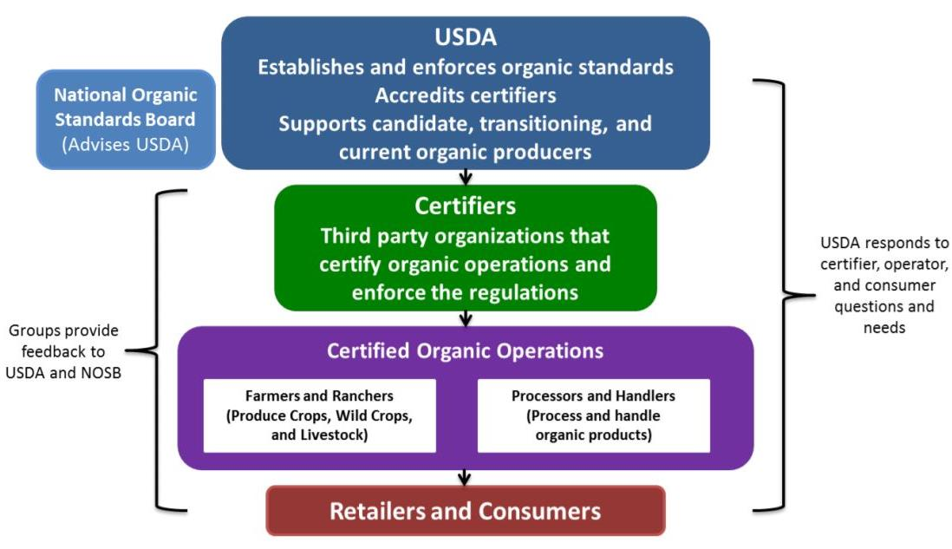
Who Regulates Organic?
Notes:
The NOSB’s job is to listen to the public and stakeholders in the organic market and make recommendations to the USDA for rule changes. This allows everyone in the chain to have a voice in regulation.
Graphic by the USDA (https://www.ams.usda.gov/sites/default/files/media/NOP_Org_Chart%5B1%5D.pdf)

Slide 15
Certified Producers Must…
Establish and implement an “Organic Farm and Livestock Plan”
Have an onsite third-party annual inspection
Be approved by an accredited certifying agent
Comply with the National Organic Program
Notes:
For a food product to have the Organic Label, it must contain at least 95% Certified Organic Products. Additionally, a product may be labeled as “Made with Organic __________” for products that are at least 70% Organically produced ingredients.

Slide 16
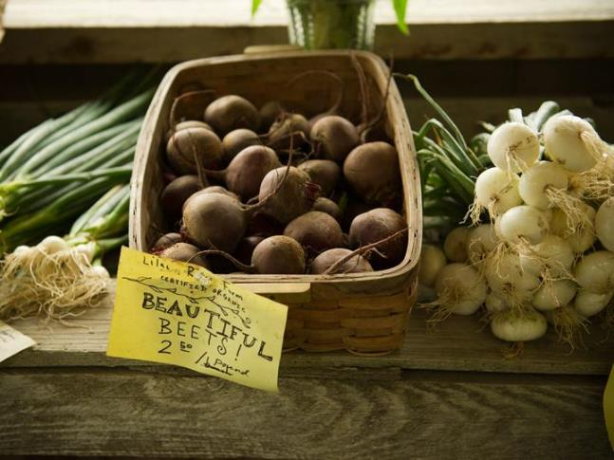
Consumer Appeal
Increased farm transparency
Health concerns
Environmental health
Taste preference
Ethical reasons
Notes:
Increased Farm Transparency
With annual inspections and USDA oversight, many consumers feel that they receive a more reliable product.
Health Reasons
Consumers feel that the organic methodology (e.g., reduced pesticides, GMO-free, pastured animals) is often a better fit for their diet, health, and lifestyle goals.
Environmental Reasons
On average, organic farms sequester more carbon dioxide, produce less greenhouse gasses, and use fewer fossil fuels.
Taste Preference
Taste is subjective, but a growing number of top chefs prefer organic ingredients.
Ethical Reasons
By requiring the natural movement of animals, many consumers view organic agriculture as more humane to animals.

Slide 17
Industry Demand
Organic currently makes up almost 5% of the overall food industry.
Over 4 million acres of certified organic land in the United States.
Accounts for $43.4 billion in revenue.
Consumer demand has shown double-digit growth in most years since the 1990s.
Notes:
Why do consumers choose a product in a store? What influences their decision?
Example: health, cost, convenience, etc.
$43.4 billion in revenue according to the Organic Trade Association (2015)
All other facts recorded by the UDSA

Slide 18
Takeaways
Organic agriculture is a management system that works with nature.
Organic agriculture is regulated by the USDA.
Organic products are clearly labeled with a government seal.
The organic industry is consumer-driven and has had very rapid growth in recent years.

